Slide 1
Scale VR Task - WebAR
R Ajay
MSc Software Systems
Coimbatore Institute of Technology

Slide 2
Tools and Technology Used
Language : python
Web Framework: Flask
Database: Sqlite3
DB Toolkit: SQLAlchemy

Slide 3
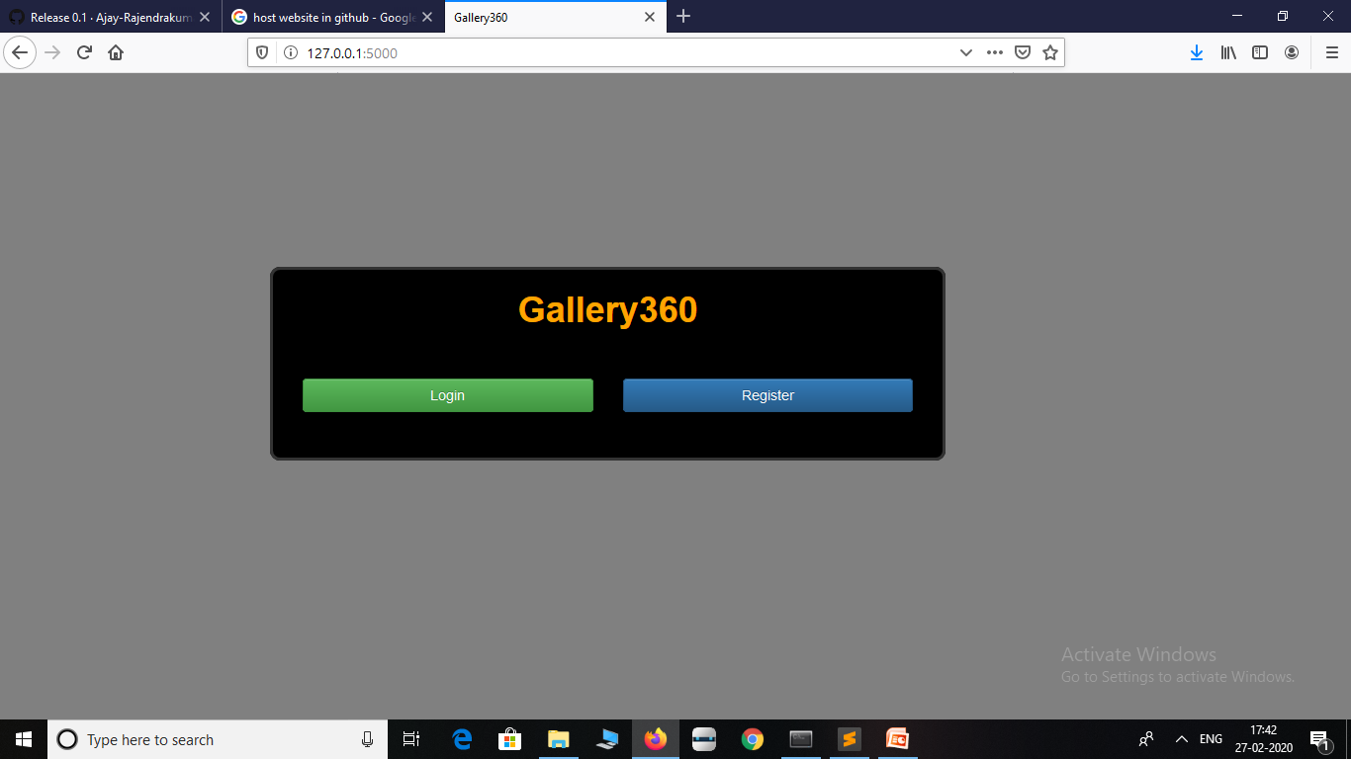
Screen Shots

Slide 4
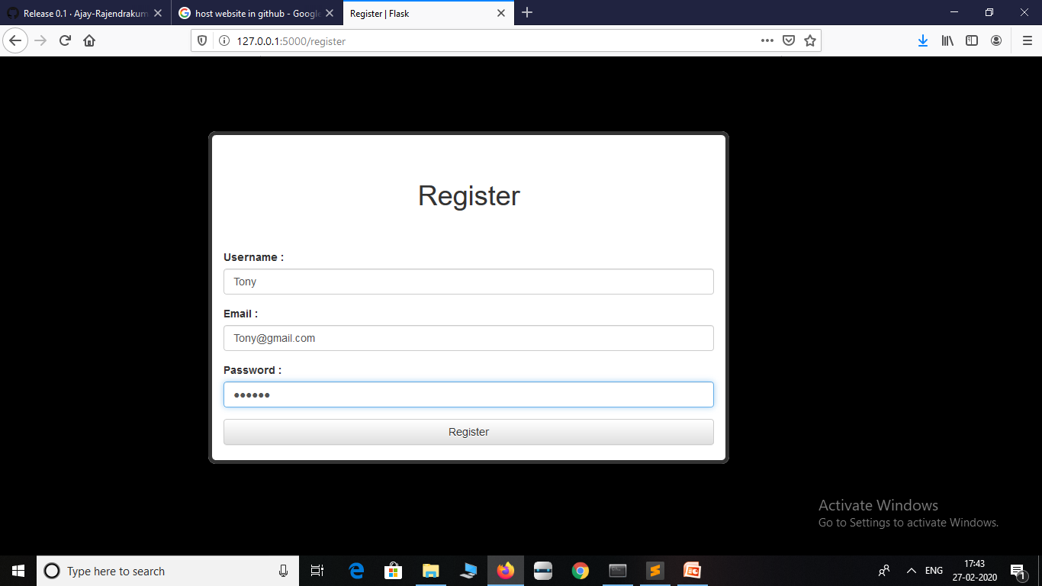

Slide 5
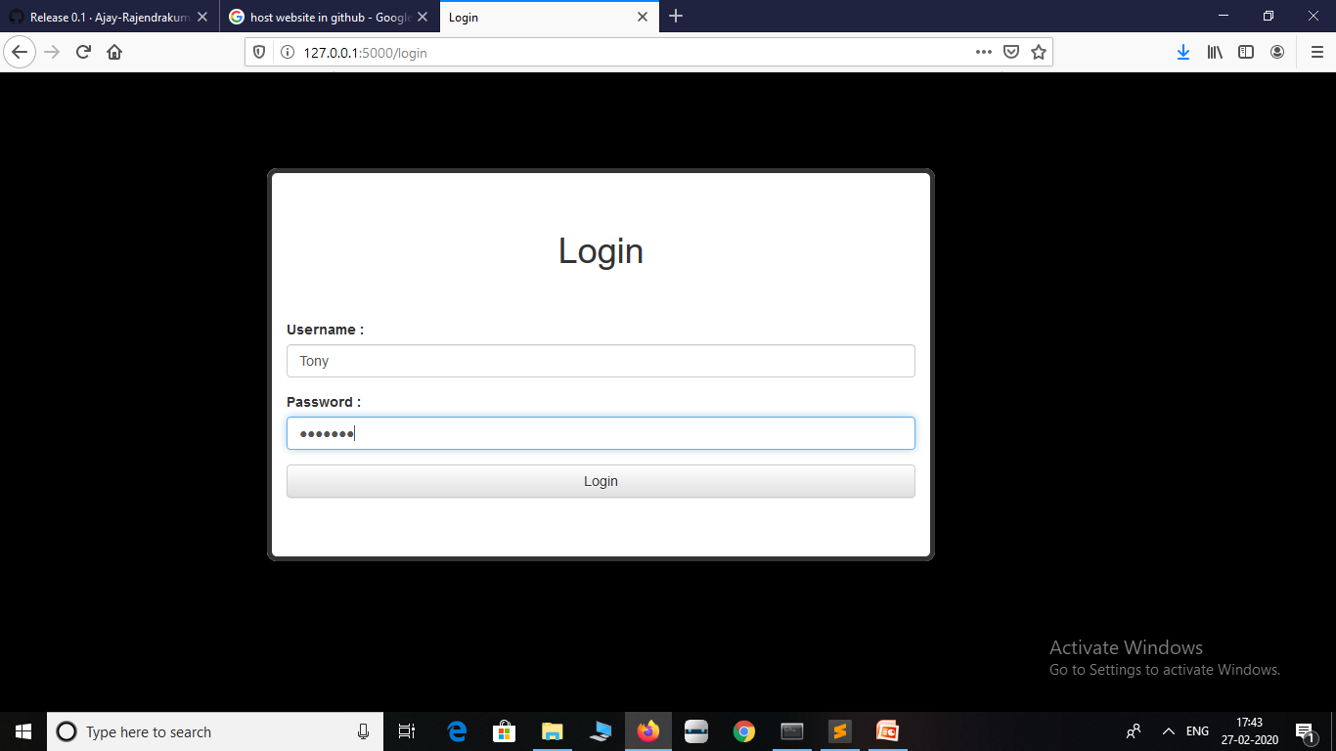

Slide 6
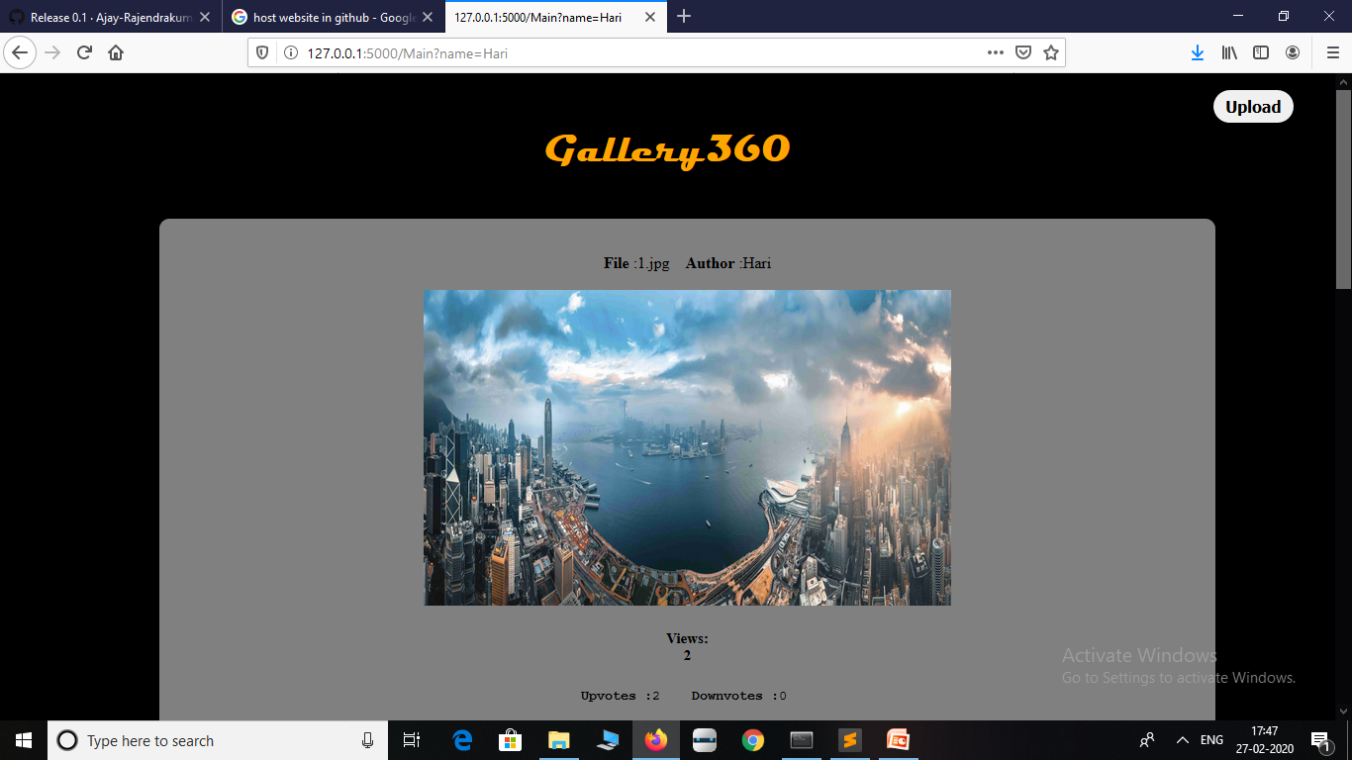

Slide 7
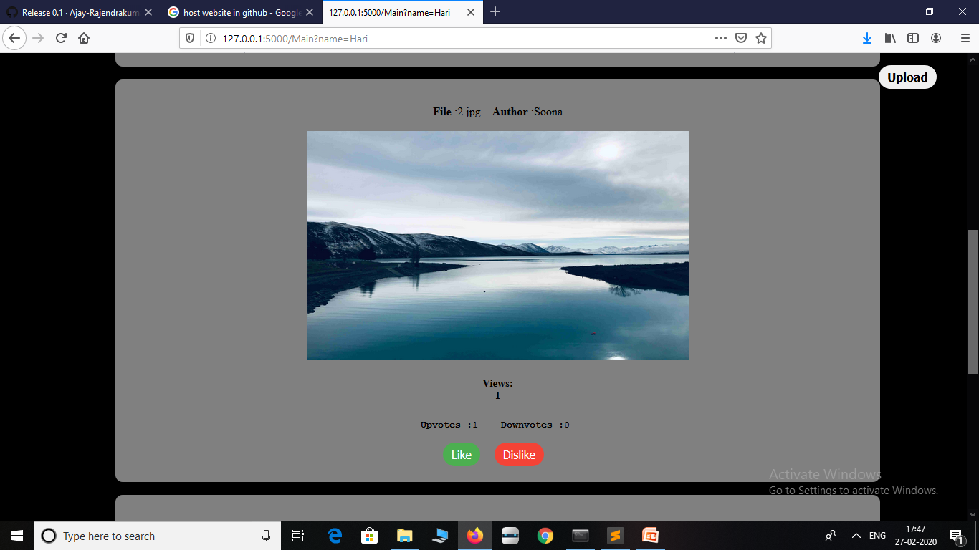

Slide 8
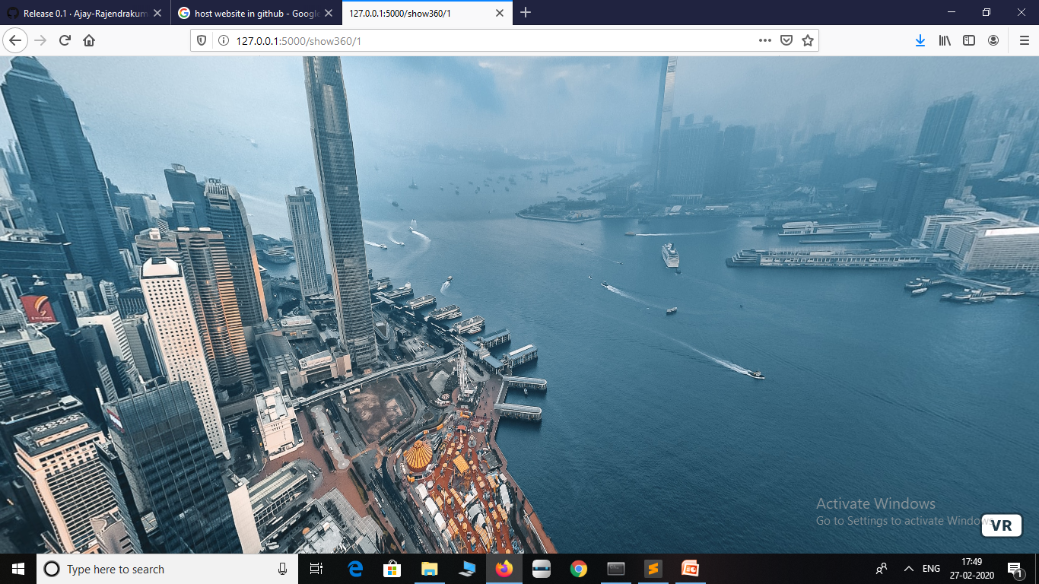

Slide 9
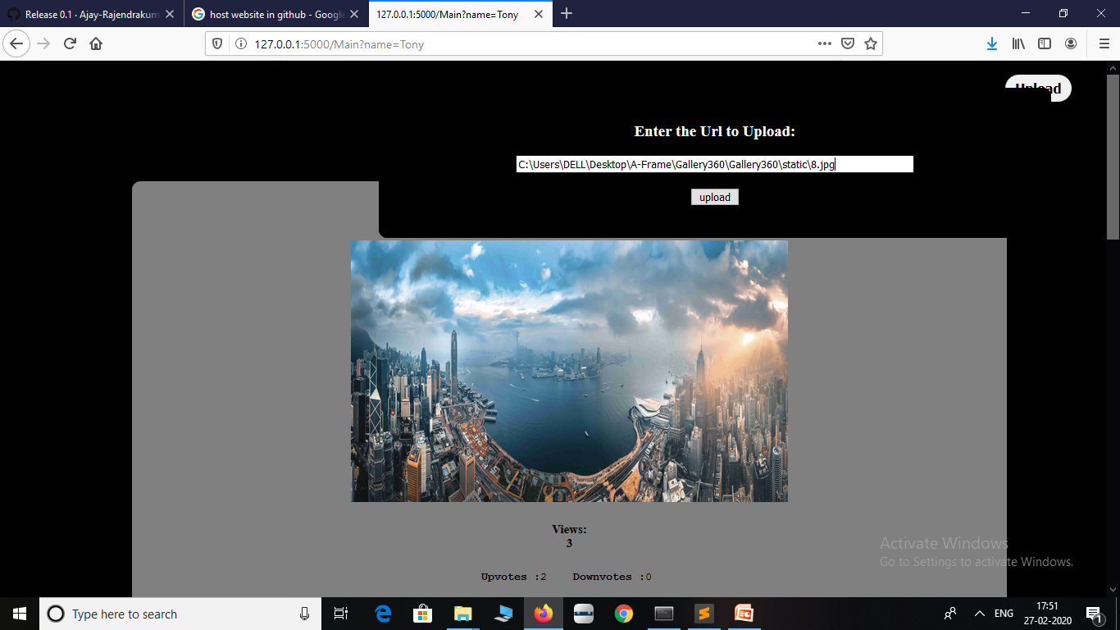

Slide 10
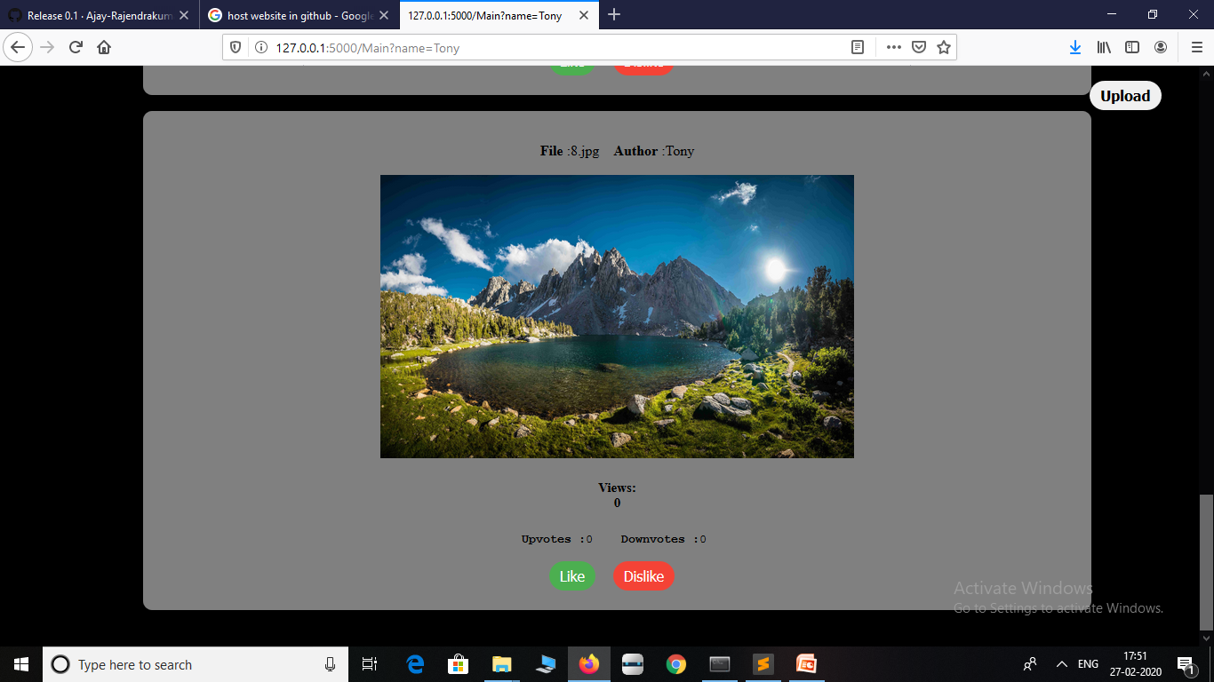

Slide 11
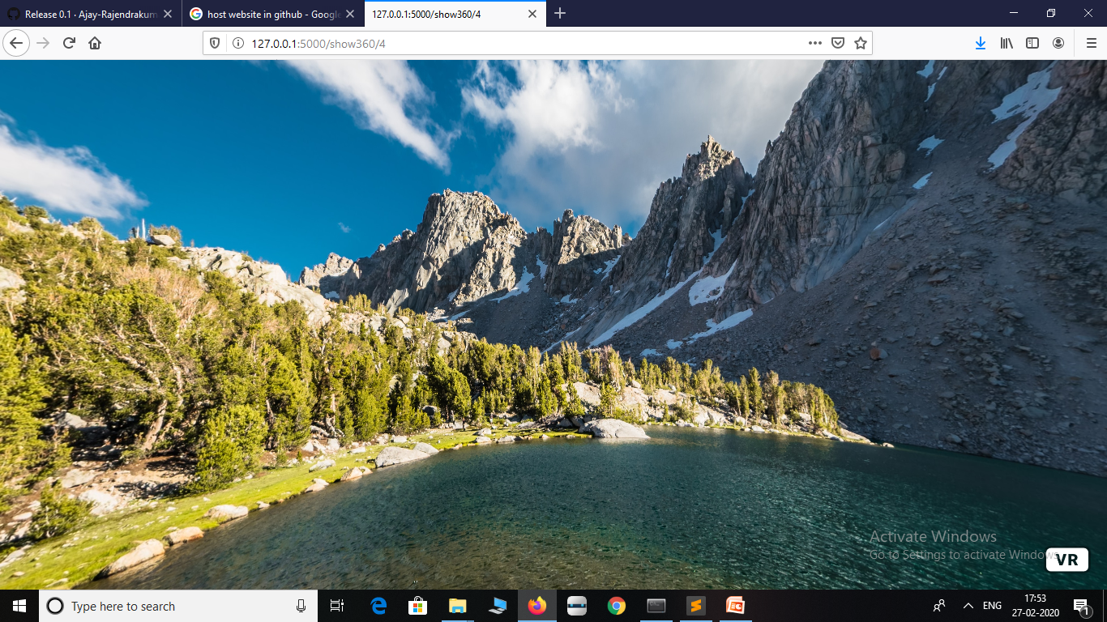

Slide 12
Drawbacks
Since project was developed using Sqlite3 as Backend Data storage (used because of considering portability), It cannot be implemented in real time system.

